Slide 1
Lightning talk 3
By sdmay22-30

Slide 2
Design Context
Broader Context
Many low power user devices need to be connected to the internet in a large area
Provide fast, reliable internet connection for many different use cases
User Needs
Industrial and agricultural devices like various sensors for soil, plants, etc require a solid internet connection
Prior Work
https://book.systemsapproach.org
https://5g.systemsapproach.org
https://www.ece.iastate.edu/~hongwei/group/publications/PRKS-TWC.pdf
Technical Complexity
Many devices that we have to account for when designing our enclosure
Modifying srsRAN algorithms to schedule packets for maximum network reliability

Slide 3
Design exploration
Design Decisions
What material to use?
How to fit every component in a small form factor?
How to power the components with one power input?
Ideation (Material)
Options: 3D printing filament, steel, aluminum, wood, fiberglass
Can the material withstand outside weather conditions?
Decision-Making and Trade-Off
Cost of material?
How easy is it to manufacture?
How well can it hold up against outside weather conditions?

Slide 4
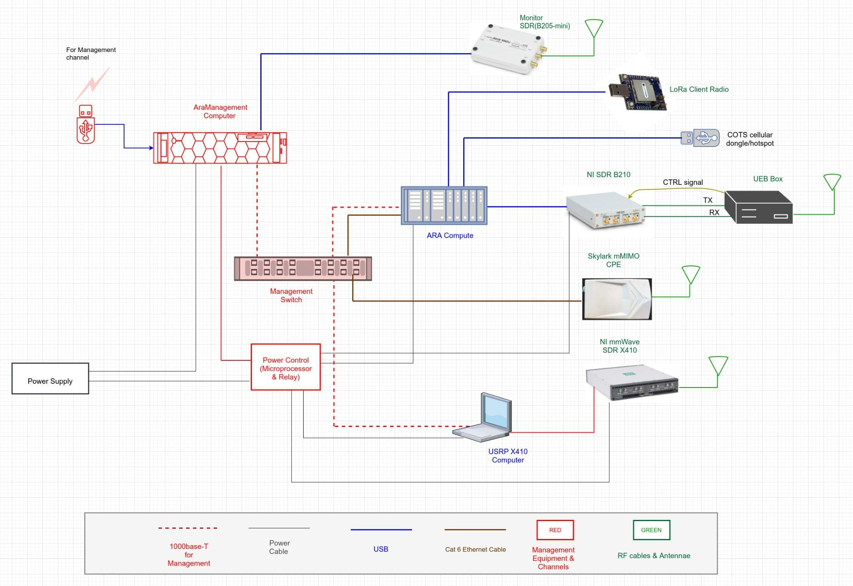
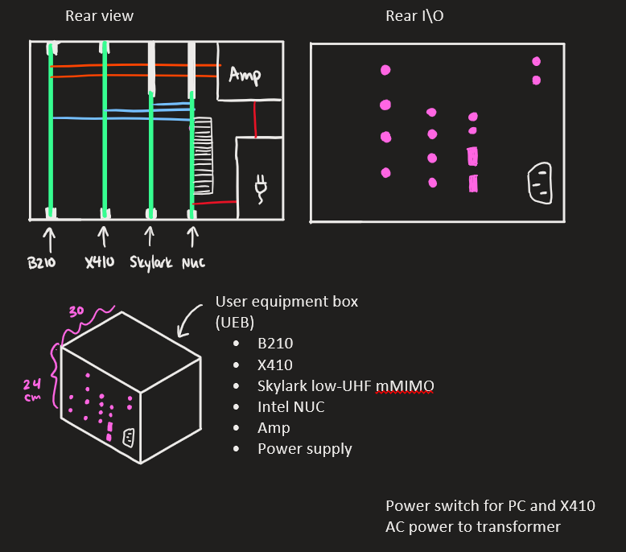
Proposed Design
Prototype a 3D enclosure to fit all the components
Look at algorithms that can be used to optimize the connection between UE and base station
Enclosure can be deployed anywhere with access to power
Modularity for different SDRs to be used
Consider thermal output of the components
Allows for remote access using the included PC
Amplification of transmitted radio signals from B210

